Slide 1
Road safety in north yorkshire
Notes:
Reported road casualties in North Yorkshire 2016 indicate that there has been a 3% increase in collisions since 2014, 2015 had 1,614 collisions. From these 31 people were killed and 399 people were seriously hurt, and more car and goods vehicles occupants are being hurt.
271 collisions in 2015 had speed as a causation factor, that equates to 15% of total collisions in North Yorkshire.
45% of the driver’s linked to a speed causation factor were aged 25-49 and 35% were aged 16-24, thus 80% of driver’s linked to speed were aged 16-49 years i.e. mainly working age adults.

Slide 2
speed
Notes:
Innapropriate speed is a major causation factor in a lot of collisions in north yorkshire
Inapropriate speed doesn’t neccesarily mean breaking the speed limit, it can just going to fast for the conditions
This time of year epsecialy, damp roads, low sunlight and dirty windscreens, all add up to make it trciky on the roads,
And you never know whats around the corner

Slide 4
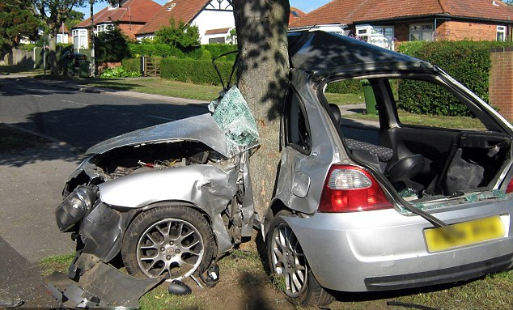
How fast must you be going to do this?
Notes:
It’s a limit, not a target, so always drive in a manner that allows you to stop in the distance you see to be clear
But then theres the other end, the over the speed limit speed, the wayyy to fast and over the speed limit
And the consequences?

Slide 5
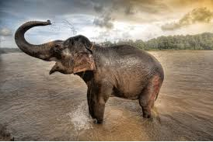
seatbelts
Notes:
ok, so we get in the car, we shut the door , we put the seatbelt on and we start the ignition
It’s a habit, its routine……but what about other people in the car, do you think there is ANY risk with others not putting on their seatbelts? Is it even your problem?
Well actually yes it is, although its thieir responsibilty to make sure they are legal and buckled in, if they are sat behind you and you are involved in a collision, its soon going to be come your problem…….
The three collisions
Lets take this for example, A 14 stone person sat in a car that’s travelling 40 mph, that car is involved in a head on collision with a tree, that’s collisions 1, just like the previous picture, that person sat in the back is thrown from their seat on impact and hits the first object, drivers seat with a force 40 times their own body weight, that’s the second collision, the human collision
Someone in the back seat weighing 180lbs (just over 12 stones) . hits other occupants (usually in the front seats) with the force of 7,200lbs (514 stones, or 3.2 tonnes. if the vehicle is traveling at 40mph, this increases as the vehicle speed increases
Then after all that you have the internal collision, the insides being stopped abruptly, this could be the heart and lungs being crushed against the now stopped ribcage and trying to burst through, resulting in cracked ribs and internal damage and bleeding
At best.
And they have hit you cos they are not restrained, do you think you would fair well with all that weight ploughing into your back?
Asian elephant
There are three collisions
There are actually three collisions in every crash: the vehicle collision; the human collision; and the internal collision (inside your body).

Slide 6
Notes:
airbags

Slide 7
Notes:
So you might be thinking, well ok, but my airbag will save me
Wont it
No, it wont, for an airbag to effectivly reduce injurys in a collsion it has to be used with a seatbelt,
The bag literally bursts from its storage site at up to 200 mph (322 kph) -- faster than the blink of an eye! A second later, the gas quickly dissipates through tiny holes in the bag, thus deflating the bag so you can move.
Anyone who's been in an accident in which the airbag has deployed can tell you that the event is extremely violent. It has to be: Airbags need to get in front of the person they're protecting and fully inflate before that person makes contact with something more harmful than the airbag itself. The average driver's side airbag inflates in 20 to 30 milliseconds, exploding out of its housing at 200 miles per hour (322 kilometers per hour) [sources: Huffman, DMV]. In fact, the technology used to deploy airbags is similar to the technology in some rocket boosters
Even though the whole process happens in only one-twenty-fifth of a second, the additional time is enough to help prevent serious injury.
Watch video
However, if those people hadnt had their seatbelts on, there would have been some huge injuries, and likewise, be aware that sitting too close is also dangerous, so make sure your seat is adjusted, the steering wheel is adjusted so the airbag aims for your chest and your head restraint is adjusted correctly

Slide 8
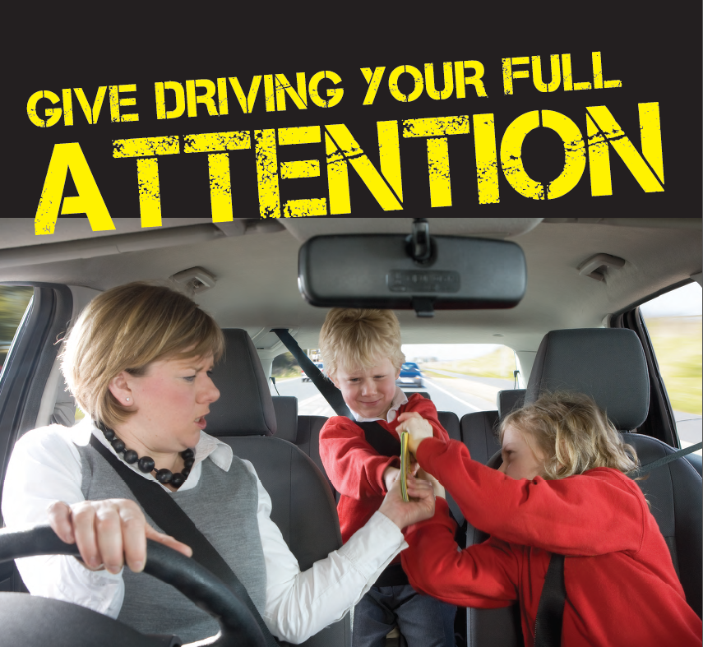
Notes:
What is a distraction
Its anything that you focus on, try to do, that isnt the main thing you are trying to do at the time
Your brain can usually only do one thing at a time, driving is a complex task, and putting extra load on your cognitive functions, ie your brain, means that something has to give
That’s usually your driving, you may not notice it, but your grip might tighten on the steering whel, your foot may lifyt off your acccelerator, or you might not ‘see’ things around you.
•In 2015, out of 1,469 fatal crashes in Britain that resulted in one or more deaths, the police recorded 400 incidences of the contributory factor of “failure to look” and a further 101 incidences of the contributory factors of driver in-vehicle distractions, distractions outside the vehicle, and phone use.

Slide 9
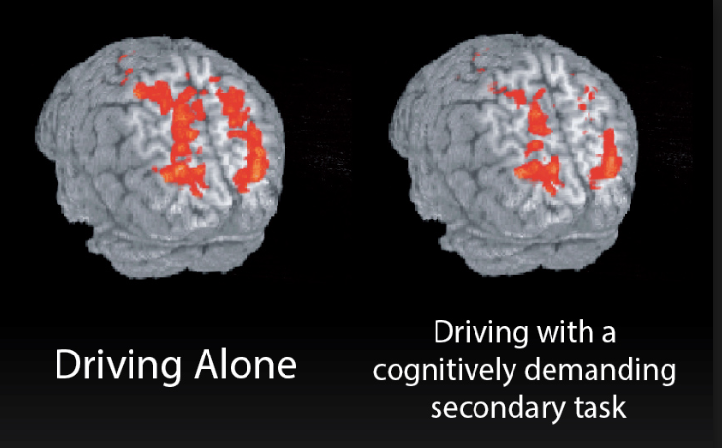
Notes:
Have you ever noticed how when you are driving somewhere new, you need to turn the radio down to see better? That’s because your brain cant focus on the radio, drive and look for streetsigns….
This is why talking on a handsfree isnt really that safe either, in a stresfull situation your passenger would pick up on it and either shut up or lend a hand, the person calling via handsfree doesn’t know that
Likewise the brain is still under pressure as studies have shown that when we speak on the phone our brainss try and visualize the person tat is calling, taking our attention away for the road and hazards ahead.

Slide 10
Notes:
Awareness test

Slide 11
Notes:
Impossible driving test

Slide 12
Road safety in North Yorkshire
Find us on social media

